Slide 1
Version Control Systems
SE489: DevOps Engineering

Slide 2
Outline
Version Control – What and Why
Version Control System Tools
GitHub and Git
Case Study: Dominion Enterprises
Git Features
Git Operations and Commands

Slide 3
Version Control – What and Why

Slide 4
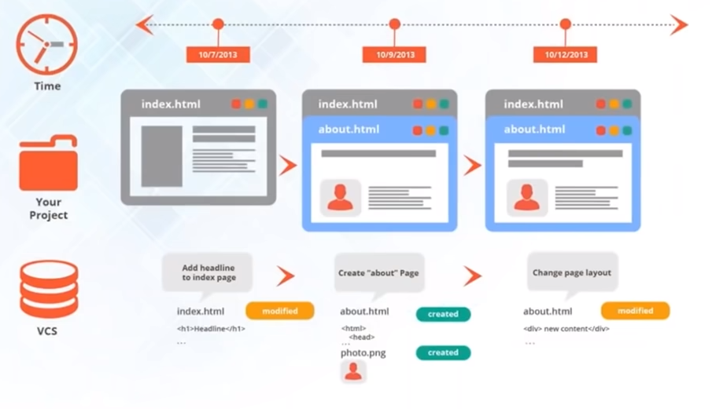
Version Control System
Version control is the management of changes to documents, computer programs, large websites, and other collections of information.
These changes are usually named “versions”

Slide 5
Version Control System
Version control, also known as source control, is the practice of tracking and managing changes to software code.
Tools that help software teams manage changes to source code over time.
Accelerate development environments by helping software teams work faster and smarter.
Help teams to reduce development time and increase successful deployments.
a.k.a. Source Code Management (SCM) and Revision Control System (RCM)

Slide 6
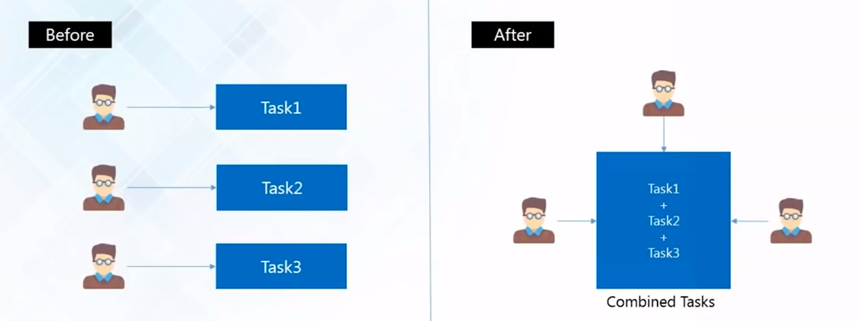
Collaboration

Slide 7
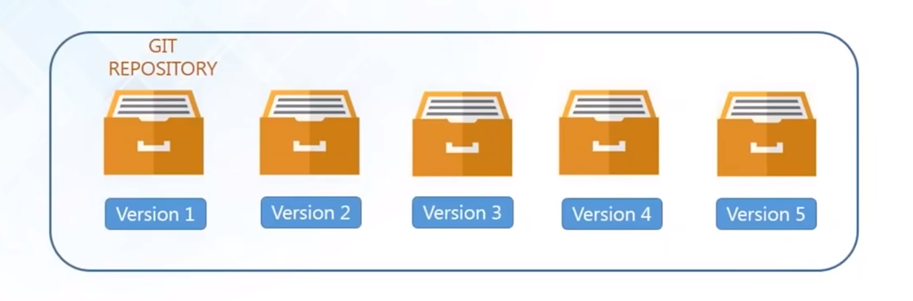
Storing Versions
Snapshots of all versions are properly documented and stored
Versions are also named accurately

Slide 8
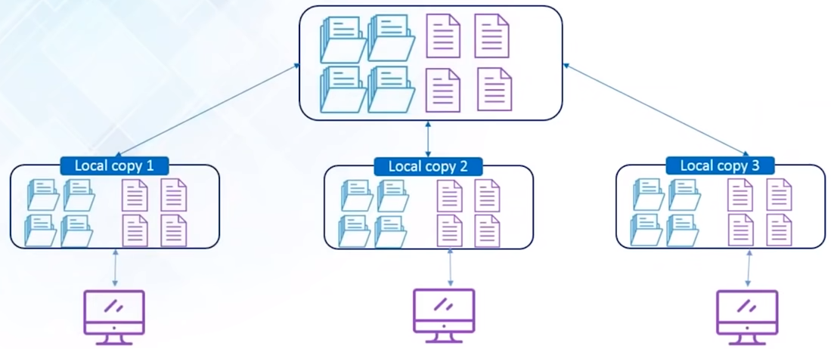
Backup
In any case if your central server crashes, a backup is always available in your local servers

Slide 9
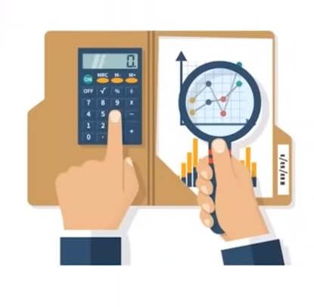
Analyze
When you change version –
VCS provides with proper description
What exactly was changed
When it was changed and by whom
You can analyze how your project evolved between versions

Slide 10
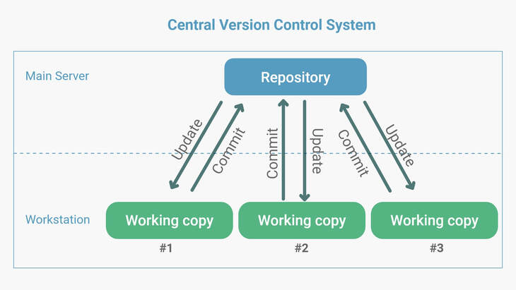
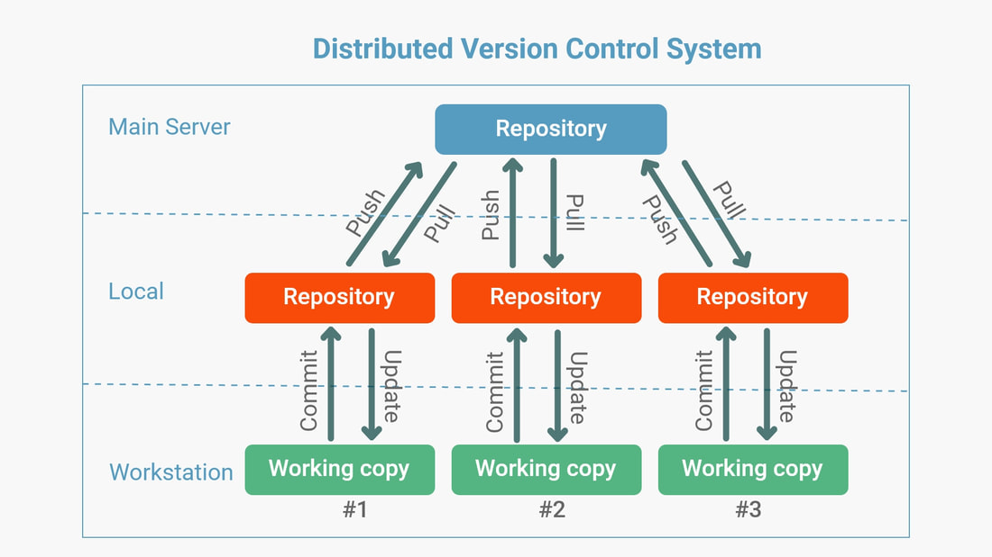
Version Control Systems Types
Location: central server
Need to be online, not locally available
Need to connect to the central server for every command
Single point of failure
Rely on the backups
Location: Distributed in nature with local copy of entire history
not necessary to be online
Only required during pushing or pulling the code
Better performance
Local backup, if remote crashes
Remote backup, if local crashes

Slide 11
But why to manage changes ?
Answering Who, Why, What, When, for Whom ….
Some benefits of such VCS
Concurrency (e.g. Google Doc vs working on same docx file through email)
Preserving collaborative history
Rollback and undo changes
Offsite source code backup
Branching and merging
Traceability
Conflict resolution

Slide 12
Version Control Systems Goals
Some goals of version control system:
Speed
Simple design
Strong support for non-linear development (thousands of parallel branches)
Fully distributed
Able to handle large projects like the Linux kernel efficiently (speed and data size)
Data integrity

Slide 13
Version Control System Tools

Slide 14
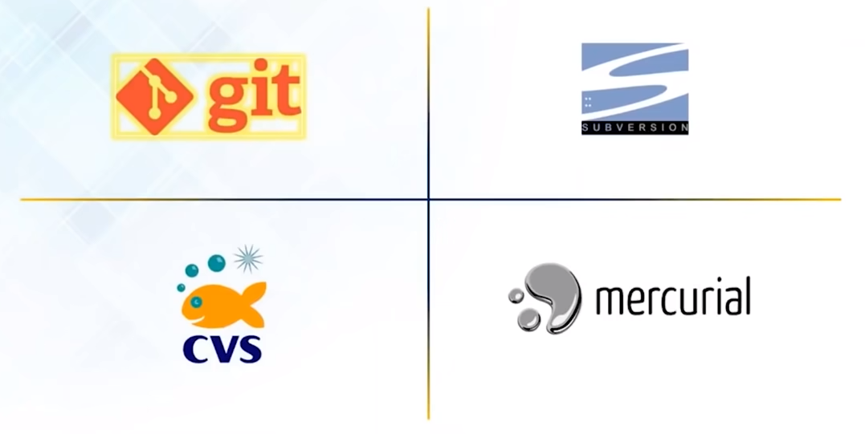
Version Control System Tools

Slide 15
Git and GitHub

Slide 16
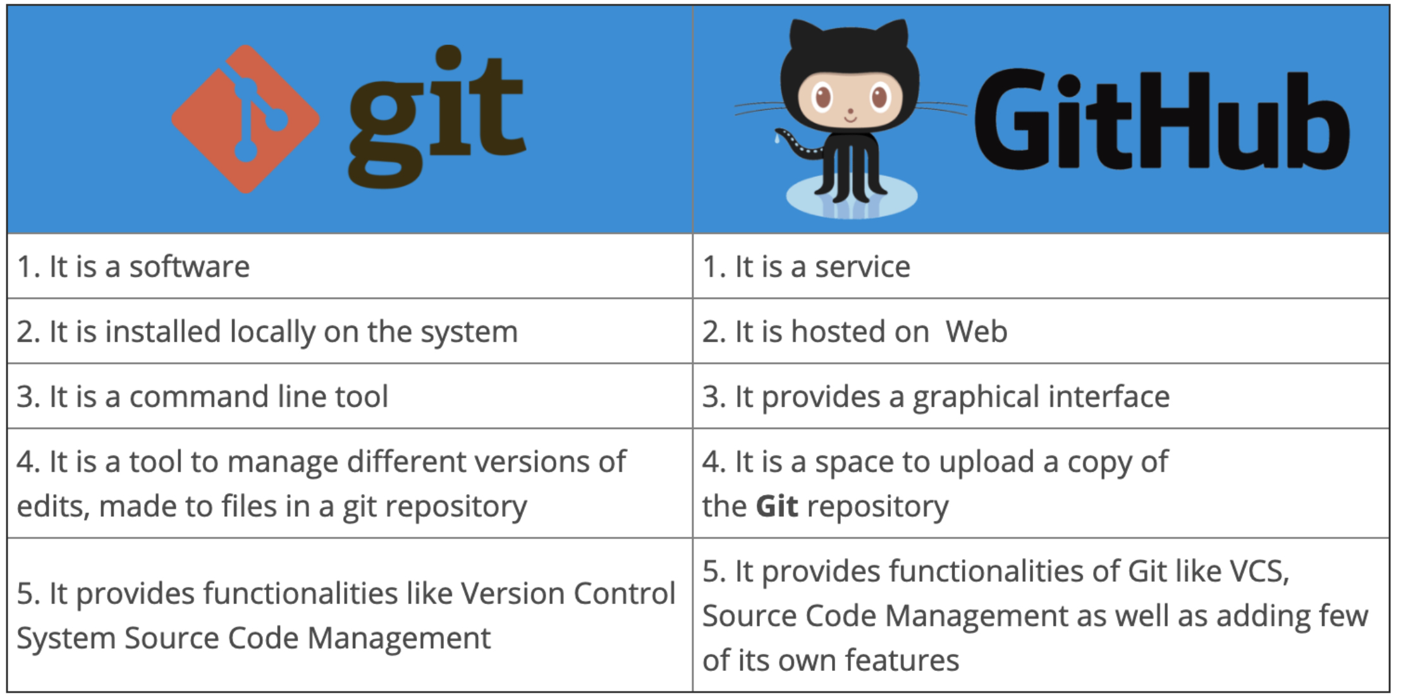
Git vs GitHub

Slide 17
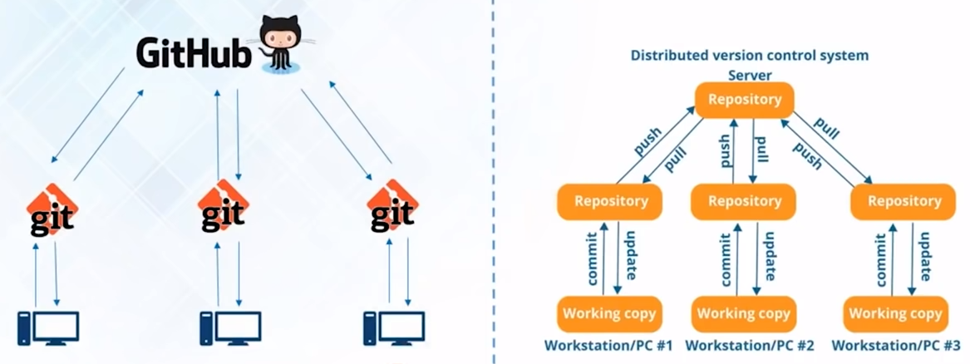
Git and GitHub

Slide 18
Case Study: Dominion Enterprises

Slide 19

Dominion Enterprises – Case Study
Problem Statement: Each team has its own goals, projects, and budgets and also have unique needs and workflows
They wanted to make private code “publicly” to make their work more transparent across the company
Private Code

Slide 20



Dominion Enterprises – Case Study
Reason for using GitHub:
They noticed some of the teams already using GitHub.
Having all their code in one place makes it easier to for them to collaborate
“GitHub allowed us to store our company’s code in a central corporately controlled system” Joe Fuller, CIO

Slide 21
Git Features

Slide 22
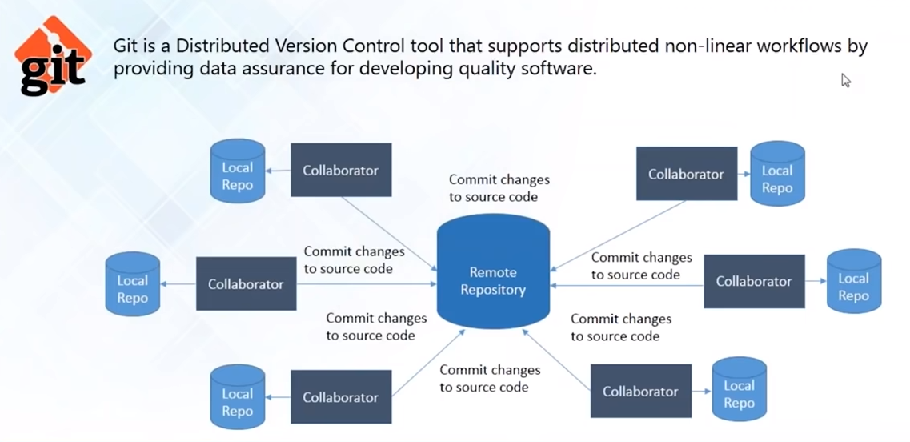
What is Git

Slide 23
Git -- Installation
Windows OS:
https://git-scm.com/download/win
macOS:
brew install git
ref: https://git-scm.com/download/mac
Linux and Unix
Ubuntu:
apt-get install git
Centos:
yum install git
Ref: https://git-scm.com/download/linux

Slide 24
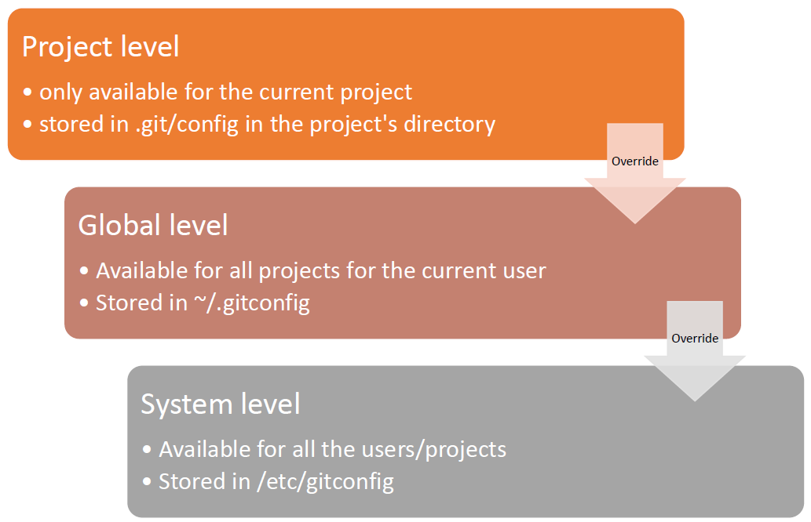
Git -- Configuration

Slide 25
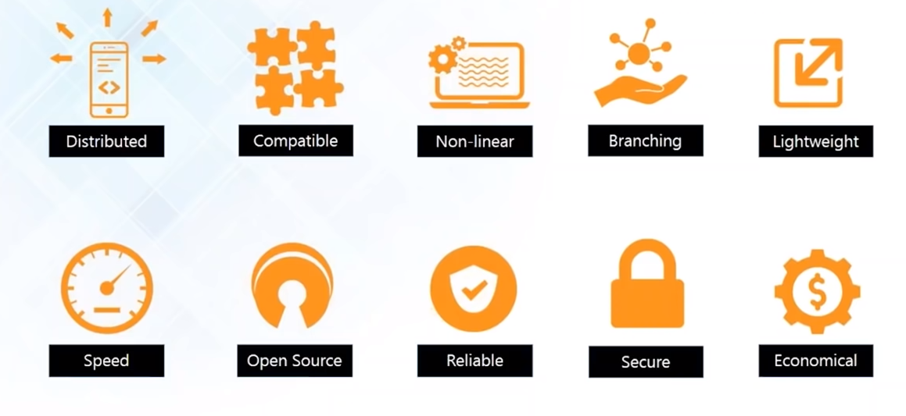
Git Features

Slide 26
Git Features
Allows distributed development of code
Every developer has a local copy of the entire development history and changes are copied from one repository to another

Slide 27
Git Features
Compatible with current systems and protocols
SVN and SVK repositories can be directly accessed using Git-SVN

Slide 28
Git Features
Supports non-linear development of software
Includes various techniques to navigate and visualize non-linear development history

Slide 29
Git Features
It takes only few seconds to create and merge branches
Master branch always contains production quality code

Slide 30
Git Features
Uses lossless compression technique to compress data on the client’s side

Slide 31
Git Features
Fetching data from local repository is 100 times faster than remote repository
Git is one order of magnitude faster than other VCS tools

Slide 32
Git Features
You can modify its source code according to your needs

Slide 33
Git Features
On events of system crash, the lost data can be easily recovered from any local repositories of the collaborators

Slide 34
Git Features
Uses SHA1 to name and identify objects
Every file and commit is checksummed and is retrieved by its checksum at time of checkout

Slide 35
Git Features
Released under GPL’s license (It is for free)
All heavy lifting is done on client-side, hence a lot of money can be saved on costly servers

Slide 36
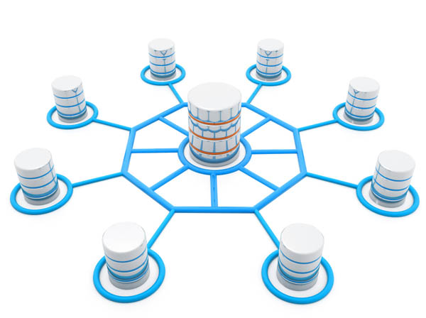
What is a Repository?
A directory of storage space where your projects can live.
It can be local to a folder on your computer, or an online storage space
There are two main types of repositories:
Central Repository
Local Repository

Slide 37
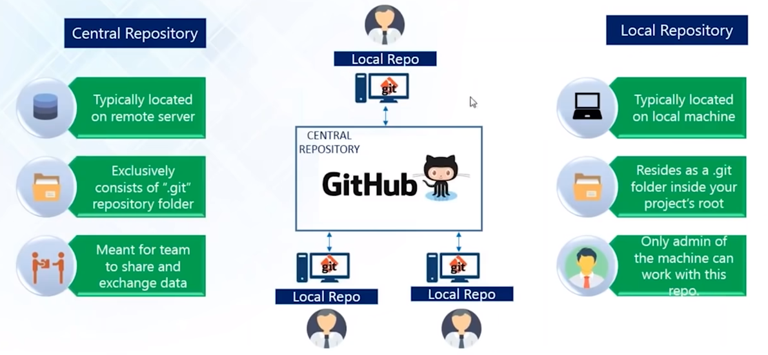
Central and Local Repository

Slide 38
Git Operations and Commands

Slide 39
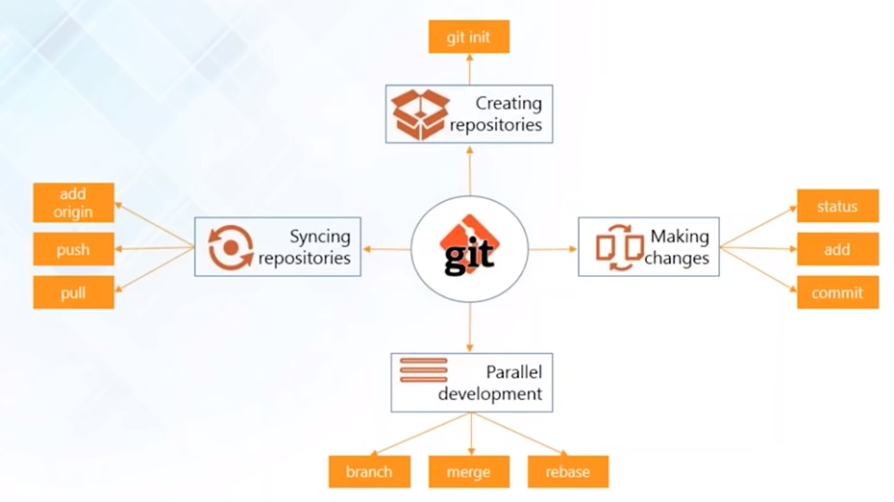
Git Operations and Commands

Slide 40

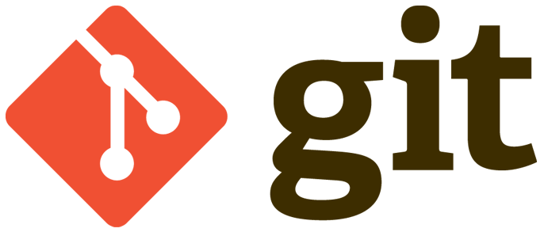
Creating Repositories
Create your central repository on GitHub
git init
Install git on your local machine and use “git init” to create local repository
OR
git clone
Download or clone your repository from GitHub using “git clone”

Slide 41
Syncing Repositories
Use “git add origin <link>” to add remote repo
Pull files with “git pull”
Push your changes into central repo with “git push”

Slide 42


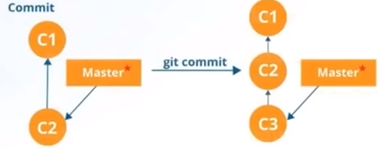
Making Changes
Tells you which files are added to the index
git status
git add
+
Lets you add files to your index
git commit
Lets you add files to your index

Slide 43
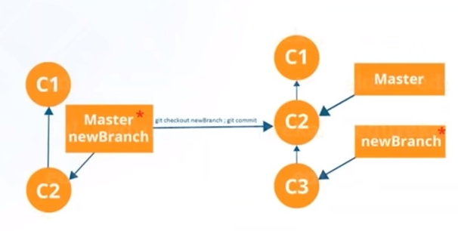
Parallel Development - Branching
Branches are pointers to a specific commit
Branches are of two types:
Local branches
Remote-tracking branches

Slide 44
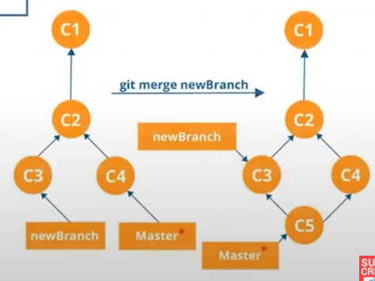
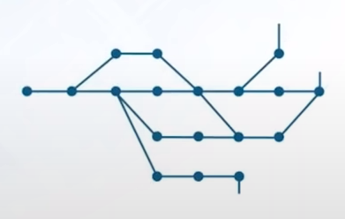
Parallel Development - Merging
It is a way to combine the work of different branches together
Allows to branch off, develop a new feature and combine it back

Slide 45
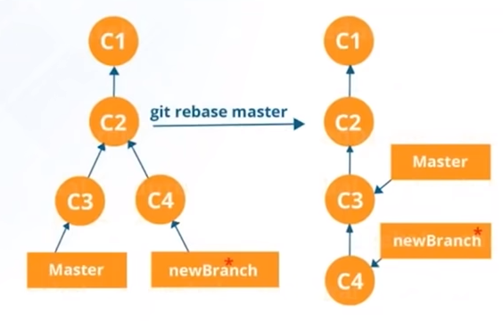
Parallel Development - Rebasing
This is also a way of combining the work between different branches
It can be used to make a linear sequence of commits

Slide 46
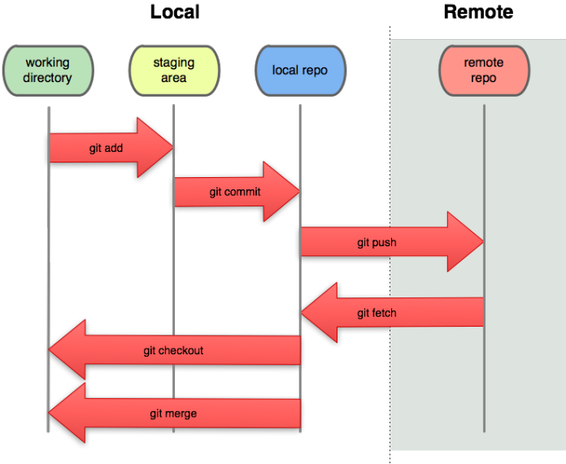
Git Flow

